Slide 1
Hamming code
Hamming code is a set of error-correction codes that can be used to detect and correct the errors that can occur when the data is moved from the sender to the receiver.

Slide 2
Redundant Bits
The redundant bits are some extra binary bits that are not part of the original data, but they are generated & added to the original data bit.
All this is done to ensure that the data bits don't get damaged and if they do, we can recover them.

Slide 3
How many redundant bits to be added?
2^r ≥ m + r + 1
where, r = redundant bit, m = data bit
Suppose the number of data bits is 7, then the number of redundant bits can be calculated using: = 2^4 ≥ 7 + 4 + 1
Thus, the number of redundant bits= 4

Slide 4
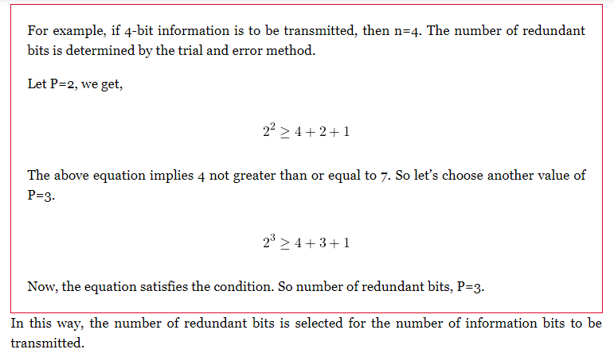
How many redundant bits to be added?

Slide 5
What is Parity Bit?
A parity bit is a bit appended to a data of binary bits to ensure that the total number of 1’s in the data is even or odd. Parity bits are used for error detection. There are two types of parity bits:
Even parity bit: In the case of even parity, for a given set of bits, the number of 1’s are counted. If that count is odd, the parity bit value is set to 1, making the total count of occurrences of 1’s an even number. If the total number of 1’s in a given set of bits is already even, the parity bit’s value is 0.

Slide 6
What is Parity Bit?
Odd Parity bit –
In the case of odd parity, for a given set of bits, the number of 1’s are counted.
If that count is even, the parity bit value is set to 1, making the total count of occurrences of 1’s an odd number.
If the total number of 1’s in a given set of bits is already odd, the parity bit’s value is 0.

Slide 7
Choosing the location of redundant bits
For the above example, the number of data bits n=4, and the number of redundant bits P=3.
So the message consists of 7 bits in total that are to be coded. Let the rightmost bit be designated as bit 1, the next successive bit as bit 2 and so on.
The seven bits are bit 7, bit 6, bit 5, bit 4, bit 3, bit 2, bit 1.
In this, the redundant bits are placed at the positions that are numbered corresponding to the power of 2, i.e., 1, 2, 4, 8,…
Thus the locations of data bit and redundant bit are D4, D3, D2, P3, D1, P2, P1.

Slide 8
Once the receiver gets an incoming message, it performs recalculations to detect errors and correct them. The steps for recalculation are −
Step 1 − Calculation of the number of redundant bits.
Step 2 − Positioning the redundant bits.
Step 3 − Parity checking.
Step 4 − Error detection and correction

Slide 9
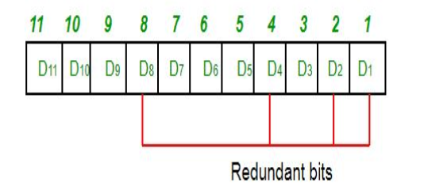
Determining the position of redundant bits
These redundancy bits are placed at the positions which correspond to the power of 2. For example:
The number of data bits = 7
The number of redundant bits = 4
The total number of bits = 11
The redundant bits are placed at positions corresponding to power of 2- 1, 2, 4, and 8

Slide 10
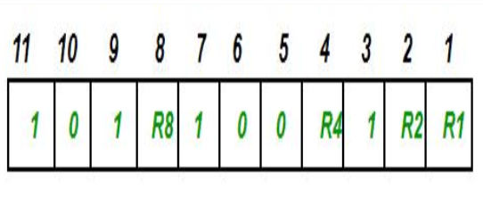
Determining the position of redundant bits
Suppose the data to be transmitted is 1011001, the bits will be placed as follows:

Slide 11
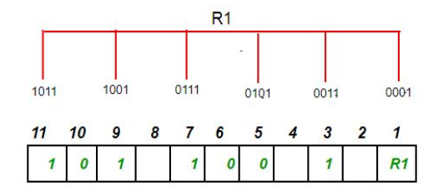
Determining the Parity bits
Determining the Parity bits –
R1 bit is calculated using parity check at all the bits positions whose binary representation includes a 1 in the least significant position.R1: bits 1, 3, 5, 7, 9, 11.
To find the redundant bit R1, we check for even parity.
Since the total number of 1’s in all the bit positions corresponding to R1 is an even number the value of R1 (parity bit’s value) = 0

Slide 12
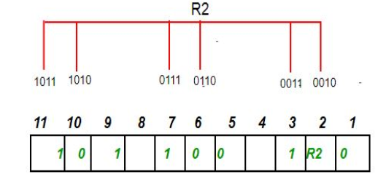
To find the redundant bit R2, we check for even parity. Since the total number of 1’s in all the bit positions corresponding to R2 is odd the value of R2(parity bit’s value)=1

Slide 13
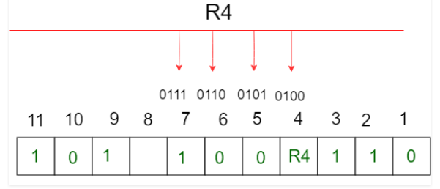
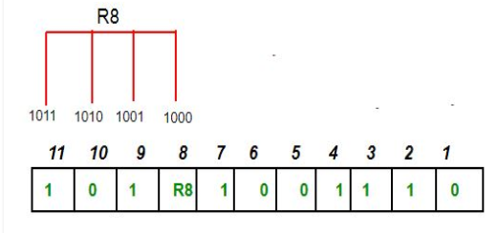
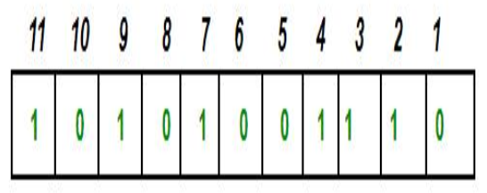

Slide 14
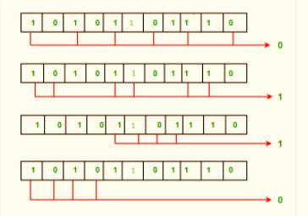
Error detection and correction
Suppose in the above example the 6th bit is changed from 0 to 1 during data transmission, then it gives new parity values in the binary number:

Slide 15
Error detection and correction
The bits give the binary number as 0110 whose decimal representation is 6.
Thus, the bit 6 contains an error.
To correct the error the 6th bit is changed from 1 to 0.

Slide 16
Error detection and correction example
https://www.studytonight.com/post/hamming-code-error-detection-and-error-correction

